Slide 1
#alltheographies
Developing an Event Model Through LEAF-LINCS Collaboration
Diane Jakacki, Bucknell University
Rachel Milio, University of Crete

Slide 2
Background
What We Do
LINCS Involvement
Contributions
LEAF development,
REED London
LEAF Site Tech, Researchers, Contributors
Vocabularies, XTriples testing

Slide 3

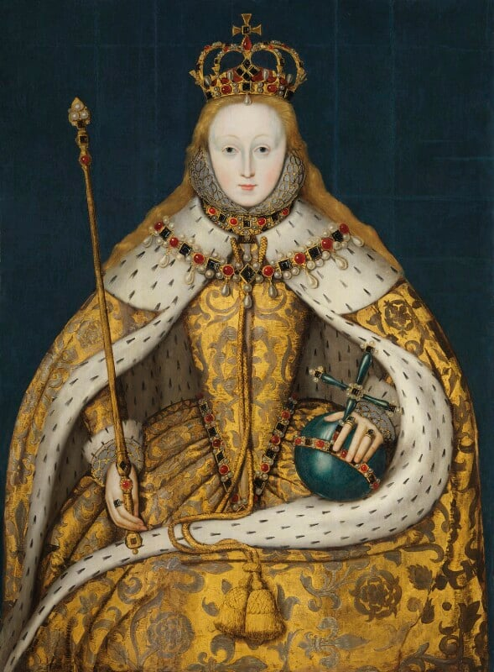
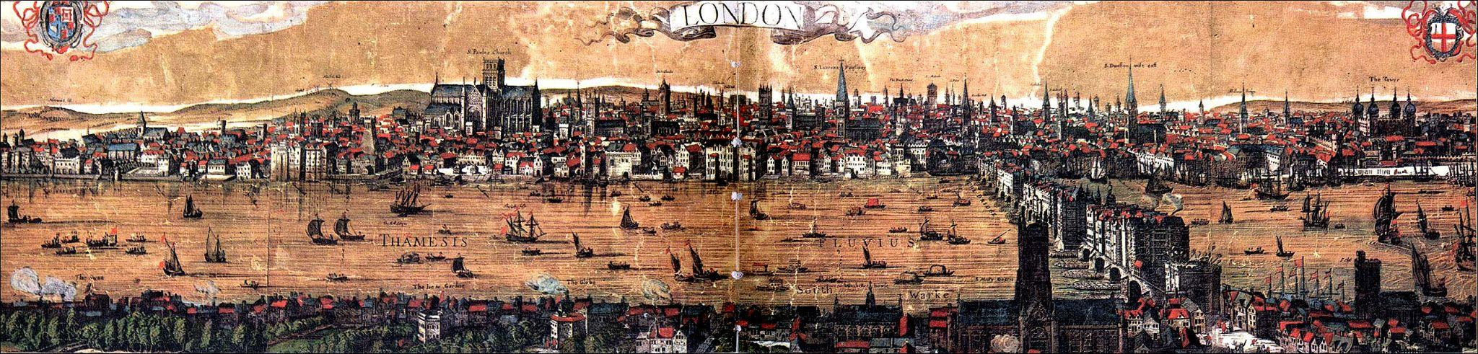

Slide 4
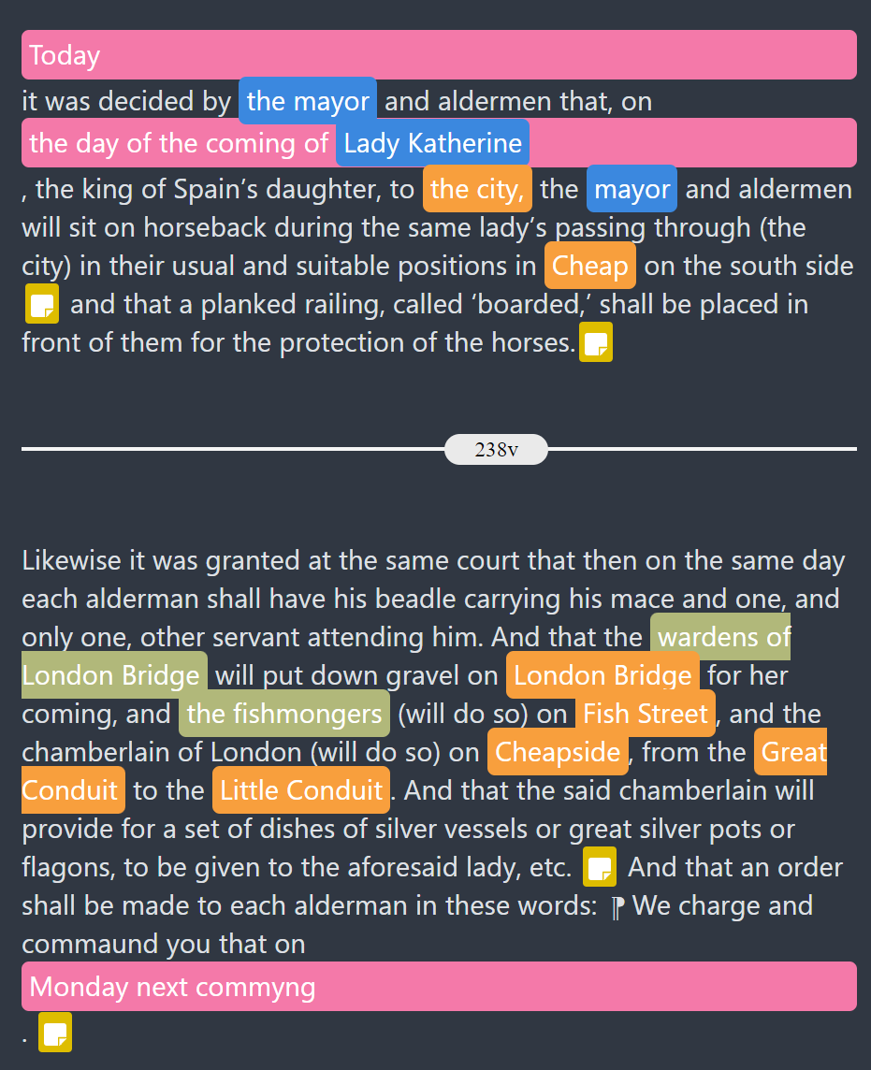
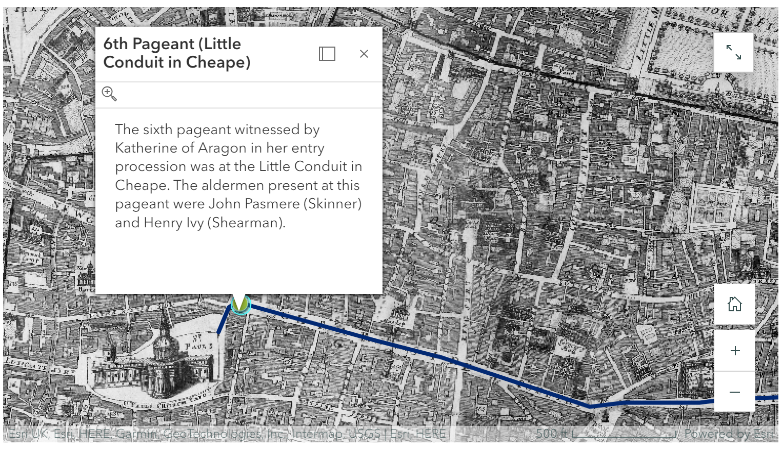
Presentation to Contextualization

Slide 5
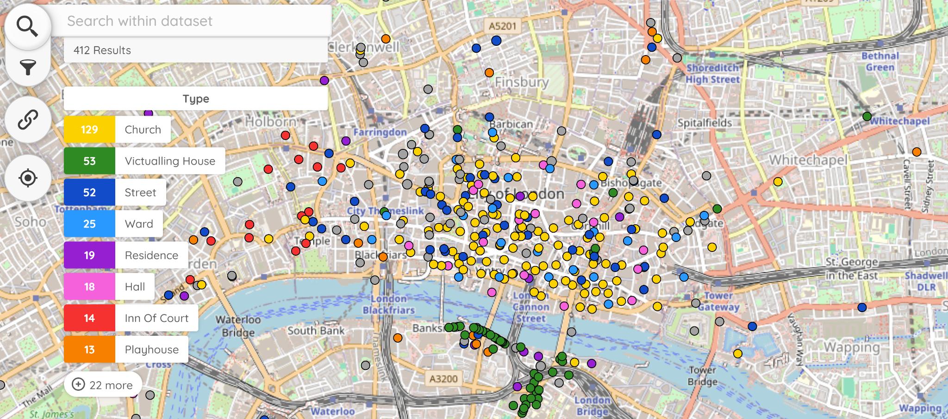
Places

Slide 6
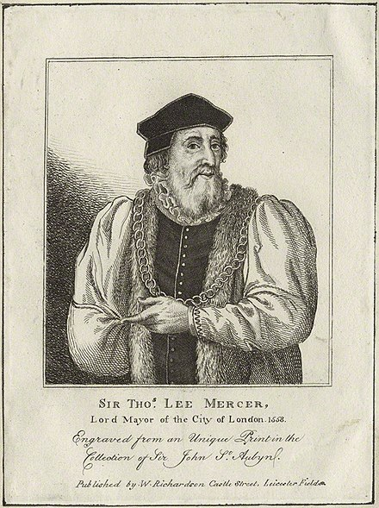
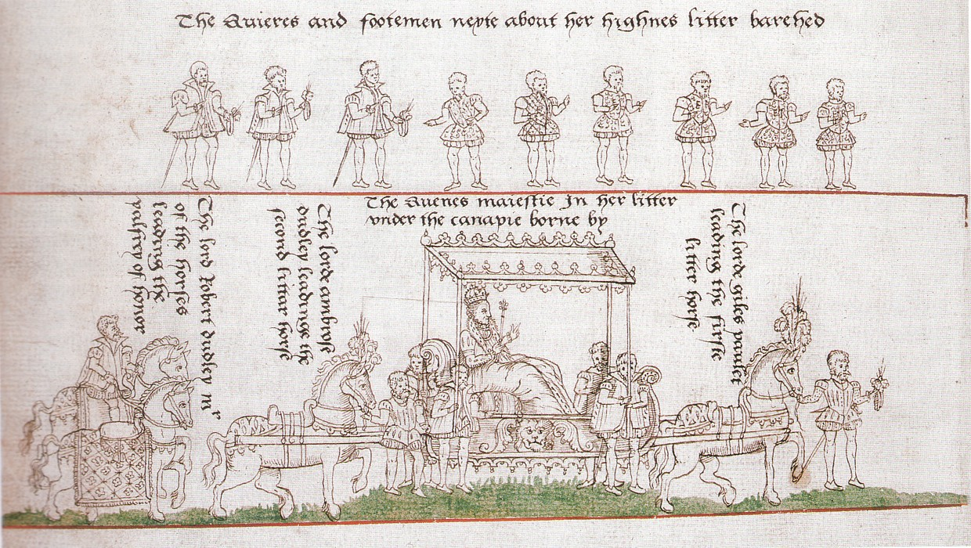
People

Slide 7
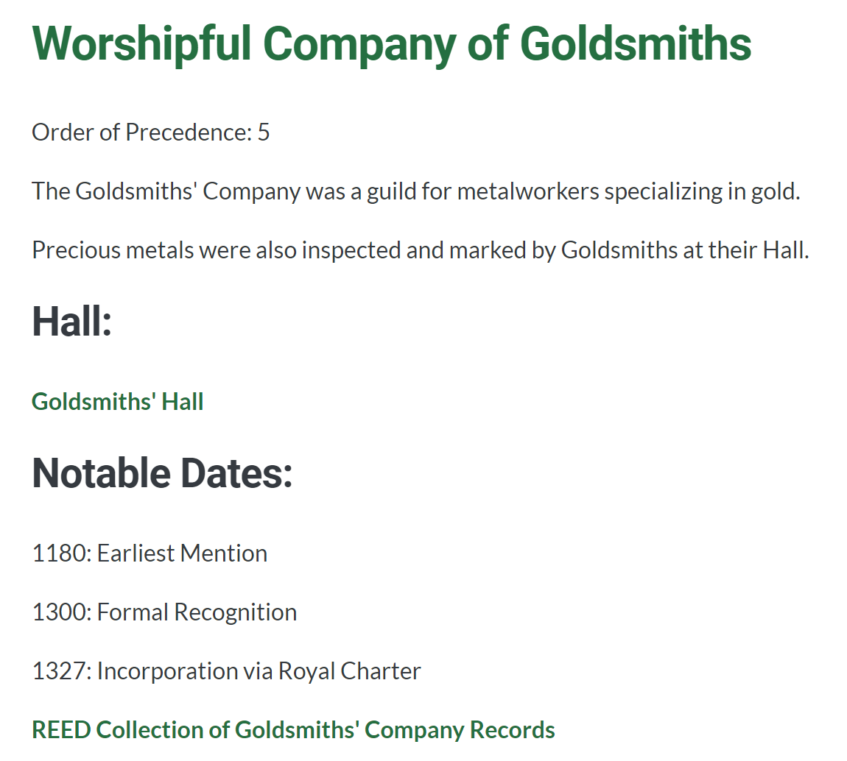
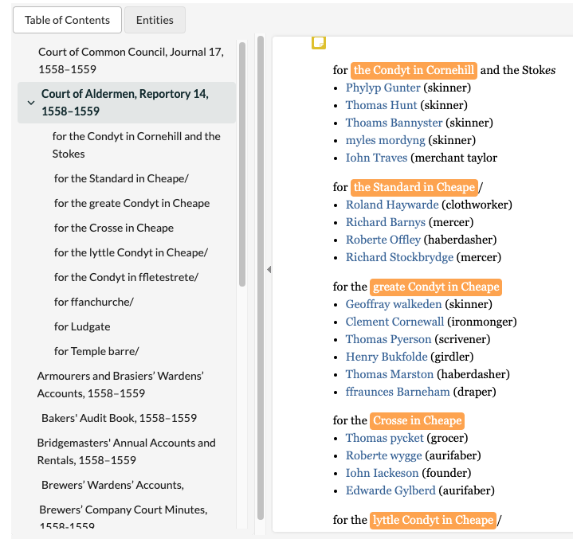
Organizations
Company Name (in 1558/9)
Order of Precedence
Brief Description
List of current and previous halls, linked to CWRC place entity
List of relevant dates in Company history
Link to REED records from company

Slide 8
Event Definition
“An occurrence that changes our understanding of time”
Has at least two of three: location, time, participants (plus evidence)

Slide 9
Event Model
Elizabeth I’s Coronation
Coronation Ceremony
Entry Procession
City’s Farewell
Lord Mayor’s Gift
Mary I’s Funeral
First
Pageant
Waits Perform
Second
Pageant

Slide 10
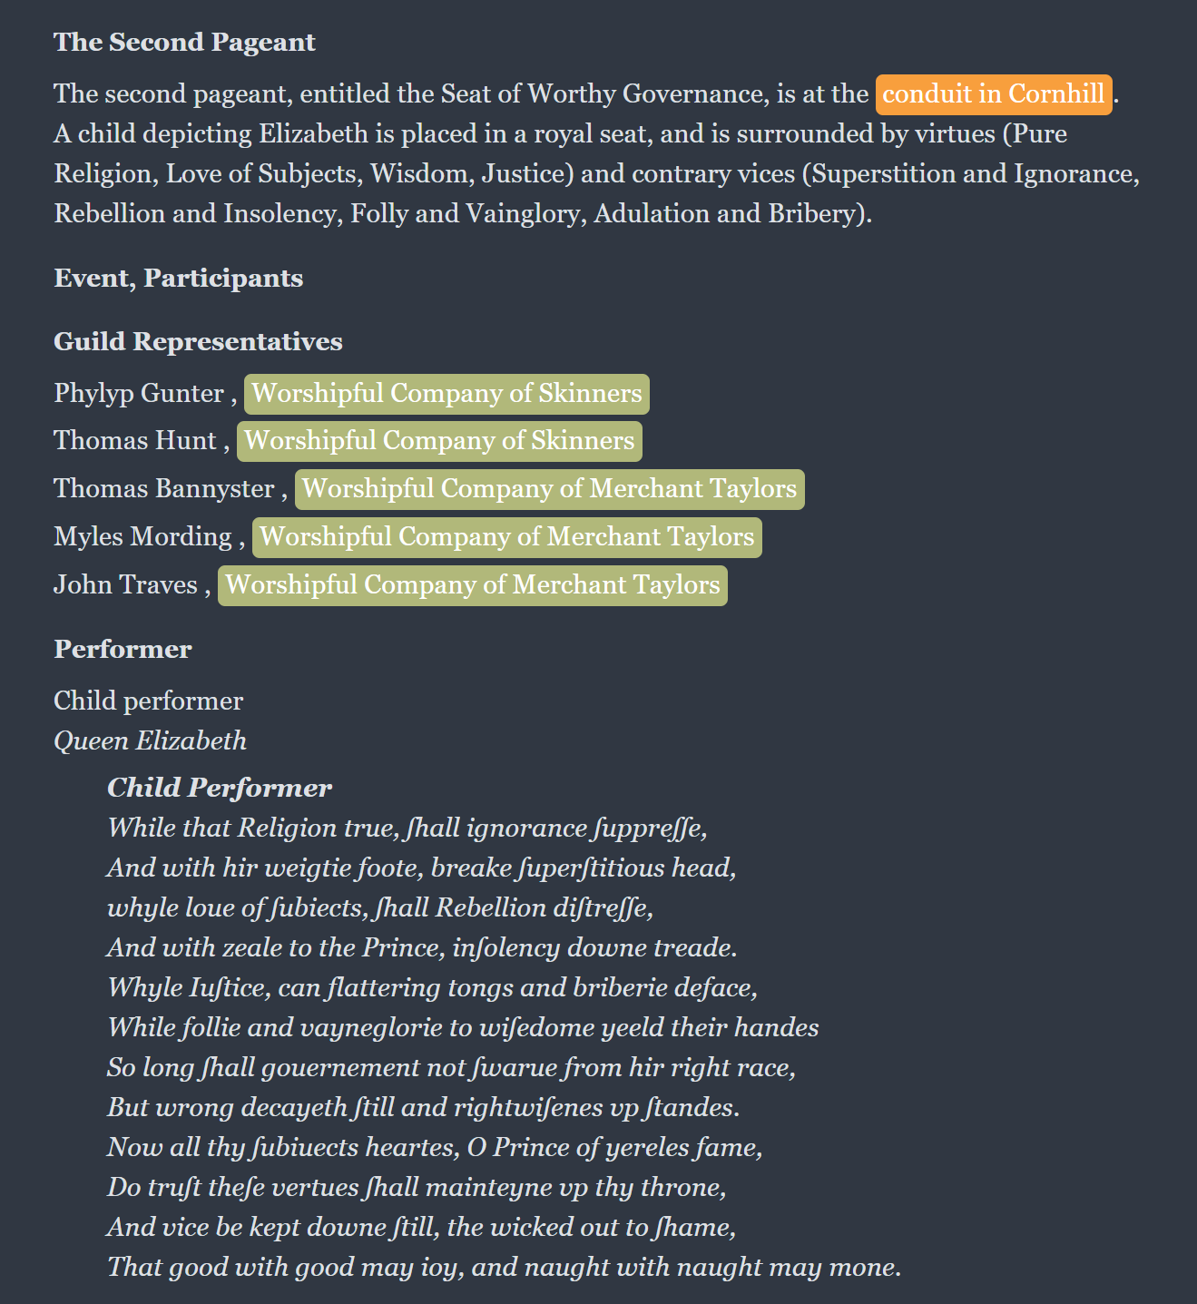
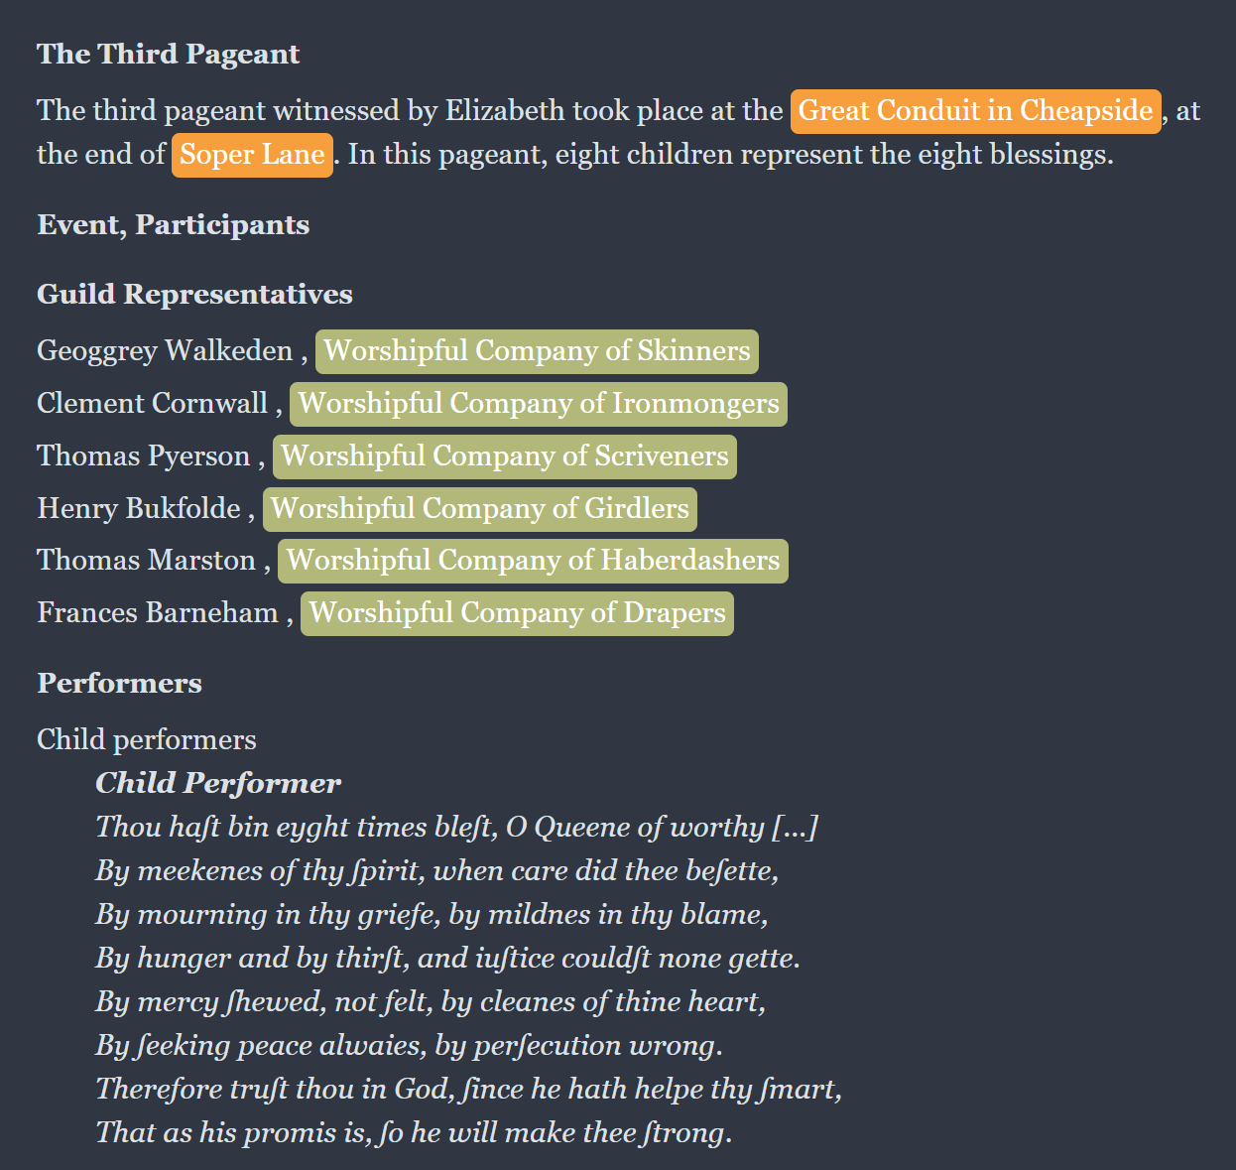
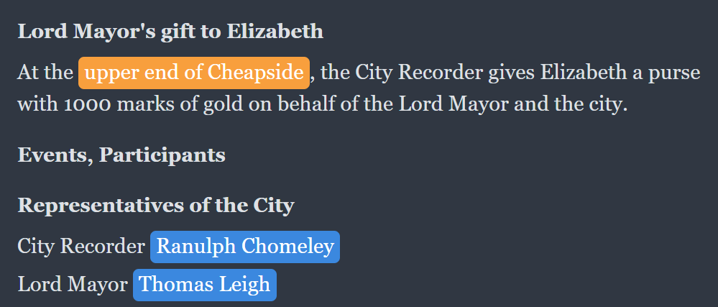

Slide 11
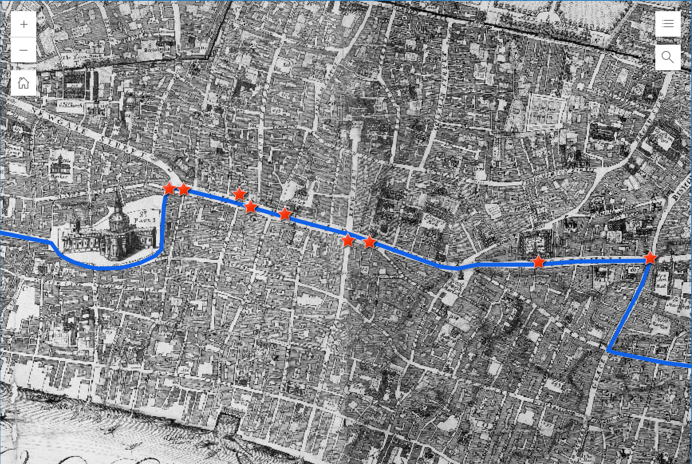





Slide 12
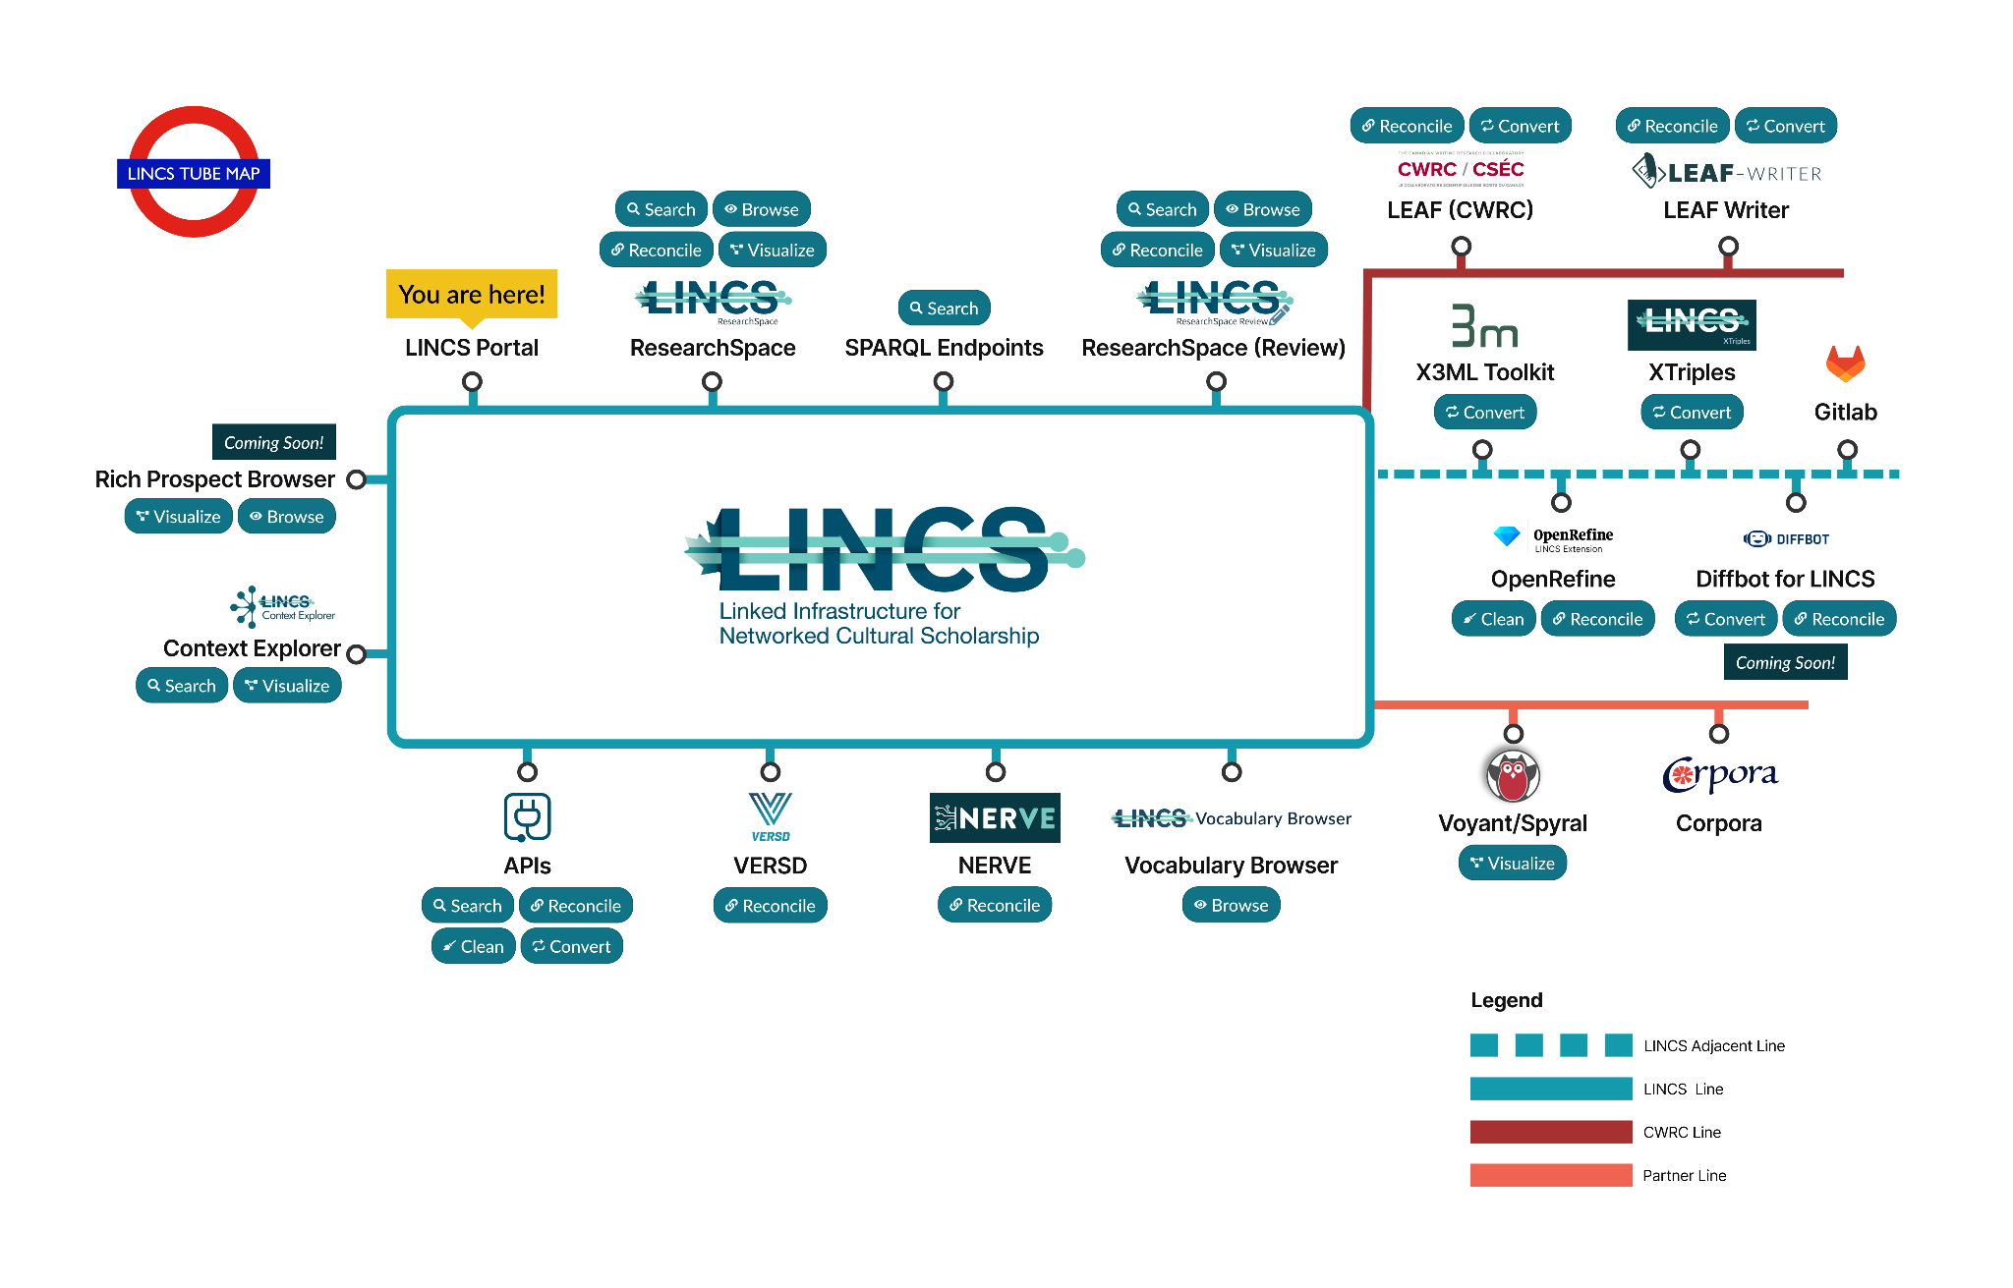
LEAF > LINCS
<The TEI Neighbourhood/>

Slide 13
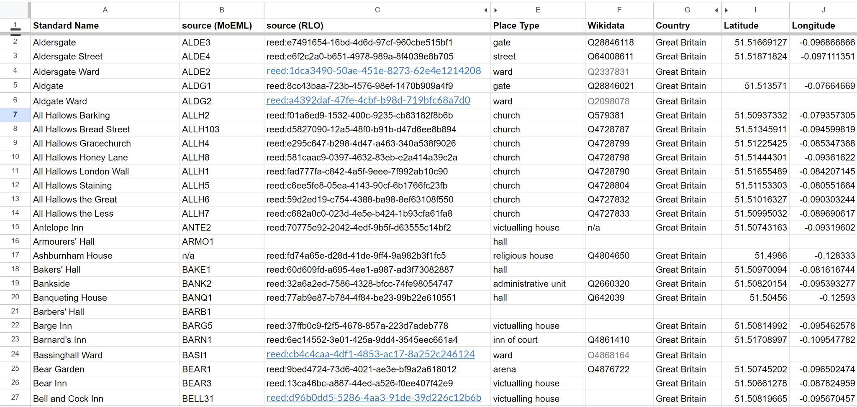

Slide 14
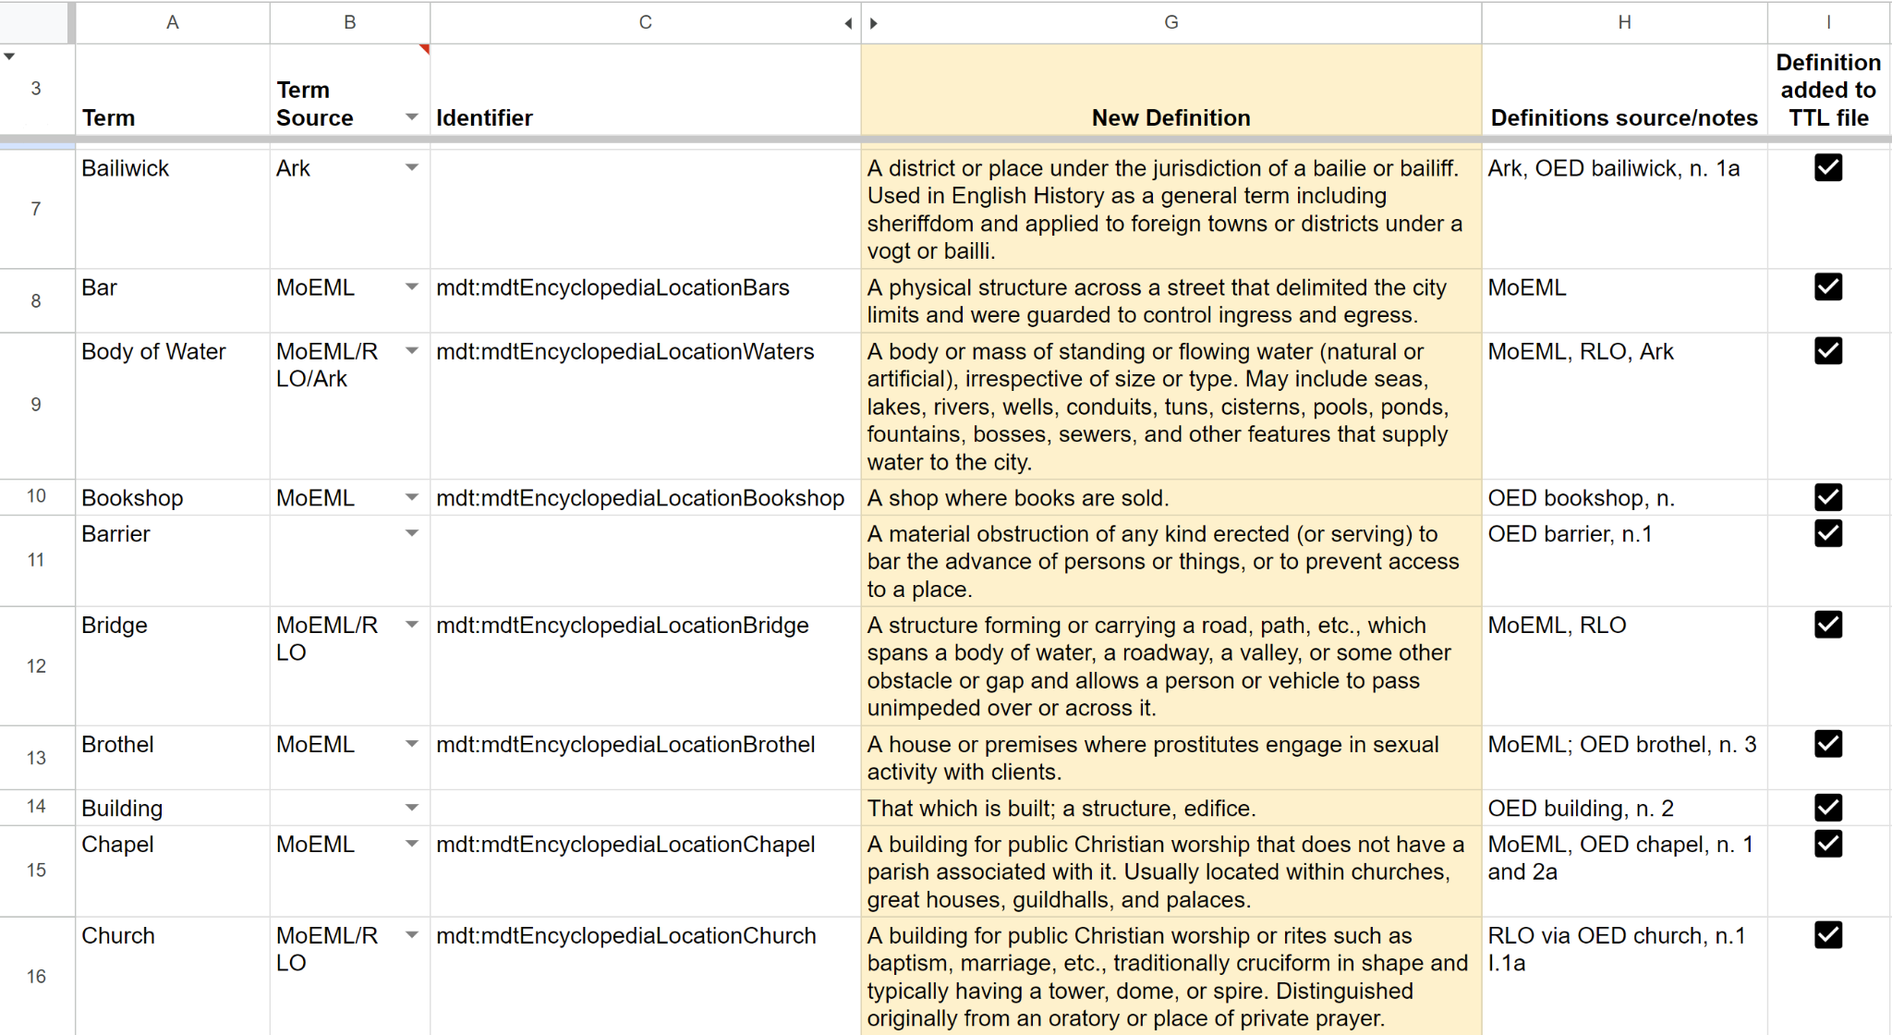

Slide 15
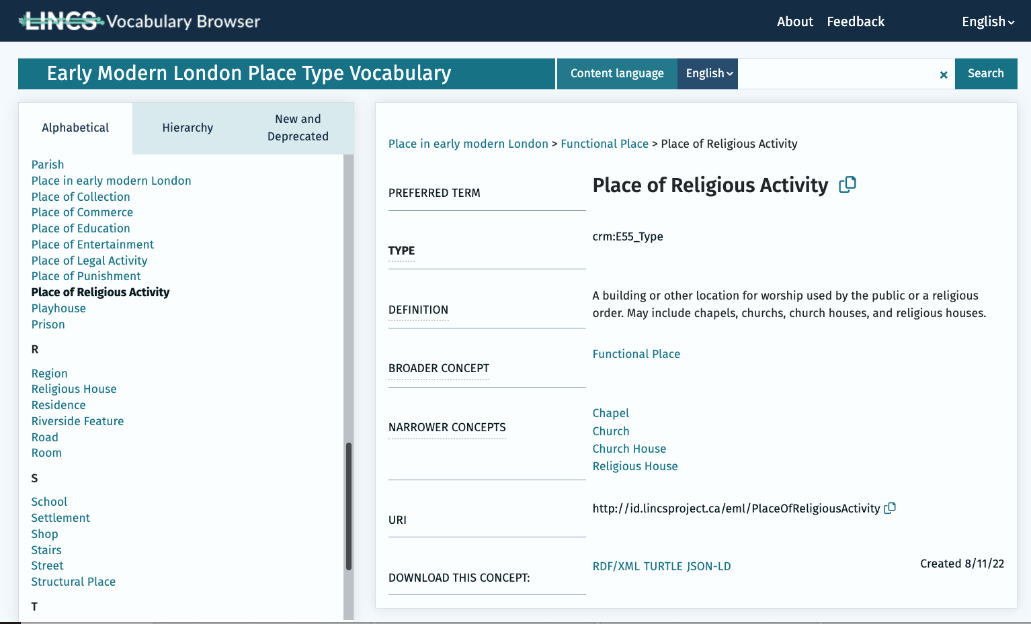
Place Type Vocabulary

Slide 16
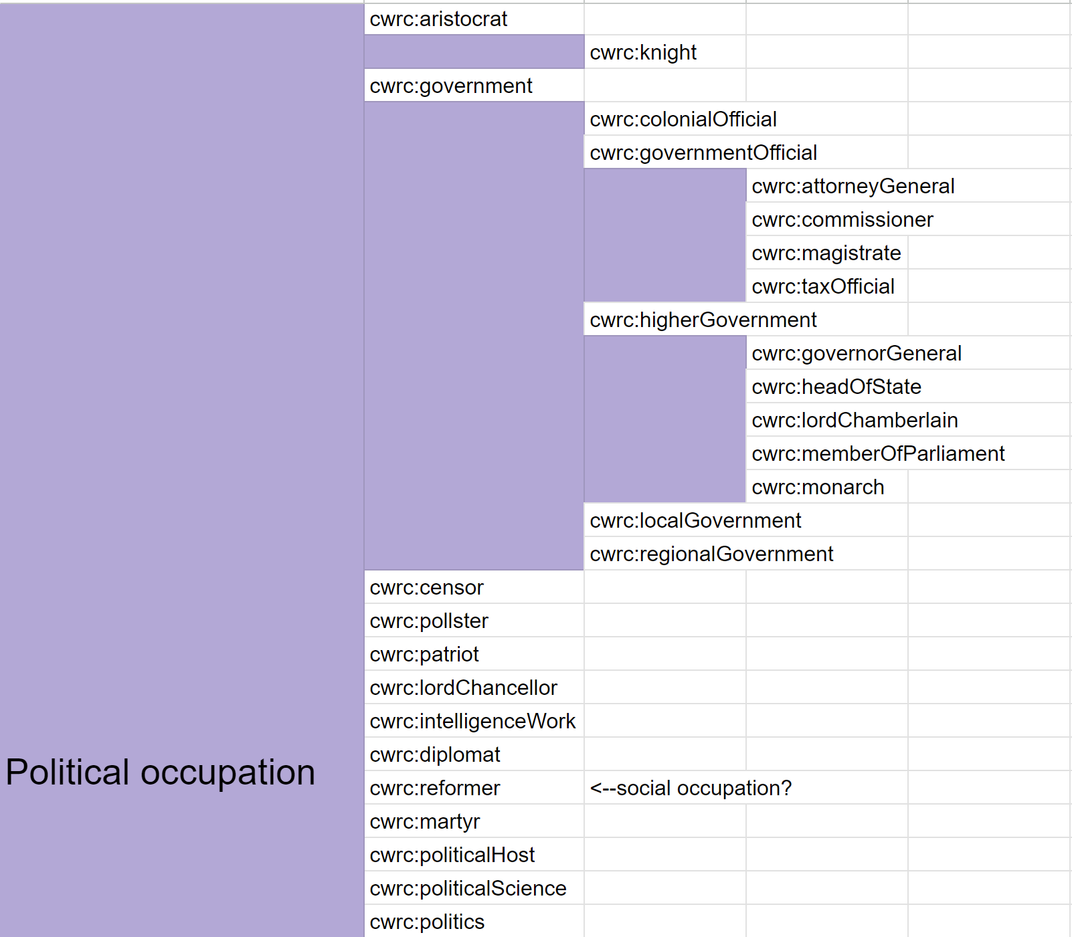
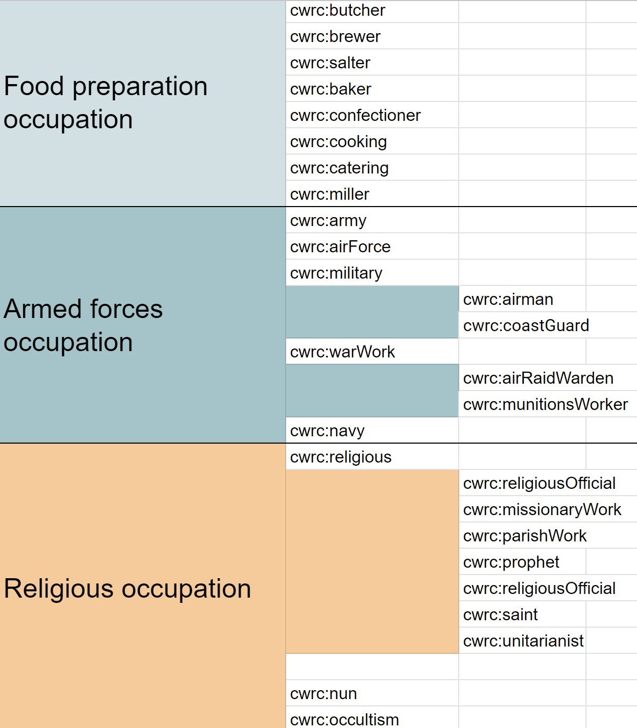

Slide 17
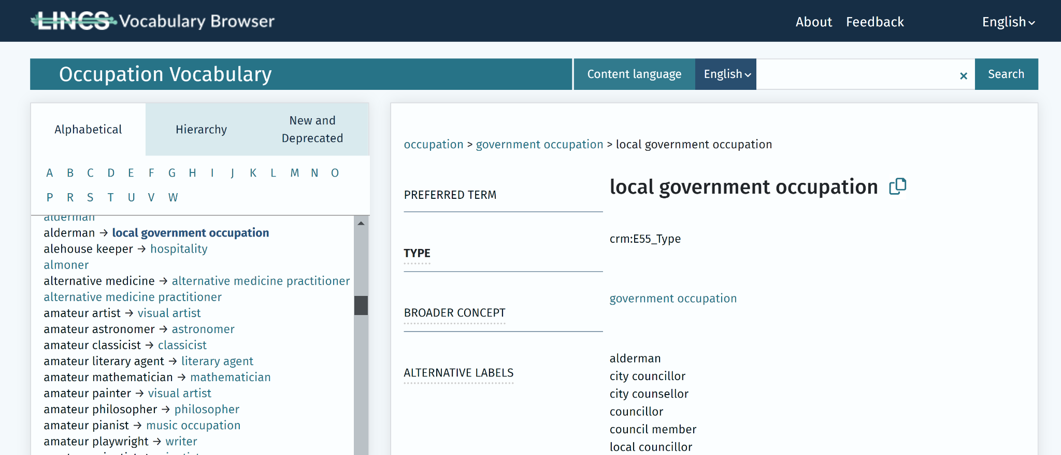
Occupation Type Vocabulary

Slide 18
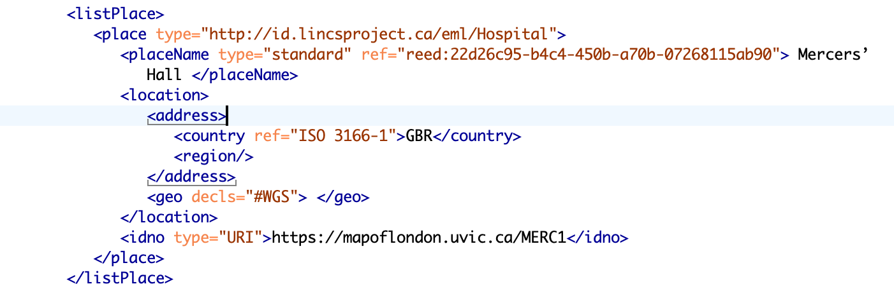
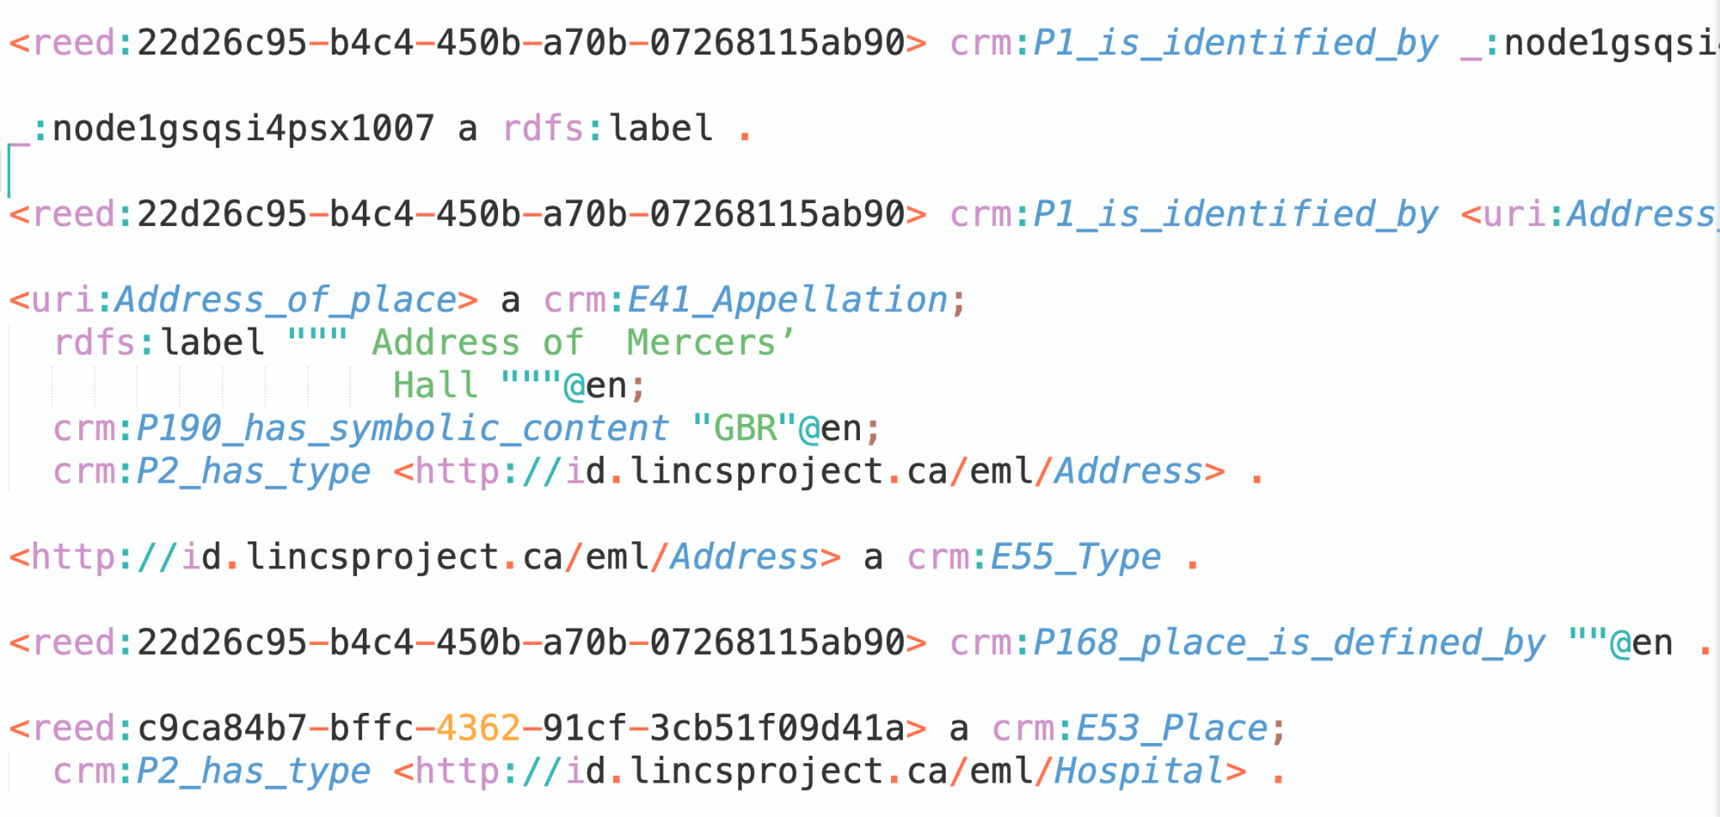

XTriples

Slide 19




Thank you!

