Slide 1
Weak Links in the Scholarly Chain of Evidence:
PIDS for Objects
Lisa Goddard
Forward Linking Conference
Ottawa, May 2024
Notes:
KM
Slides 1-5 KM 5 min
Slides 6-10 LG 5-10 min
Tool slides 15-20 min, slightly reorganizing so we can cover the ones we added/are comfortable with:
11-15 KM
15-18 LG
19-21 KM
Slides 22-24 LG
Leaving 5-10 min for discussion?

Slide 2
PERSISTENT IDENTIFIERS for Objects
Globally unique identifier for a research object.
Generally expressed as a web addressable http link.
DataCite DOI: https://doi.org/10.58066/jqpg-2136
Crossref DOI: https://doi.org/10.54590/pop.2021.006
ARK: http://n2t.net/ark:/65665/381440f27-3f74-4eb9-ac11-b4d633a7da3d
Handle: http://hdl.handle.net/1828/10652

Slide 3
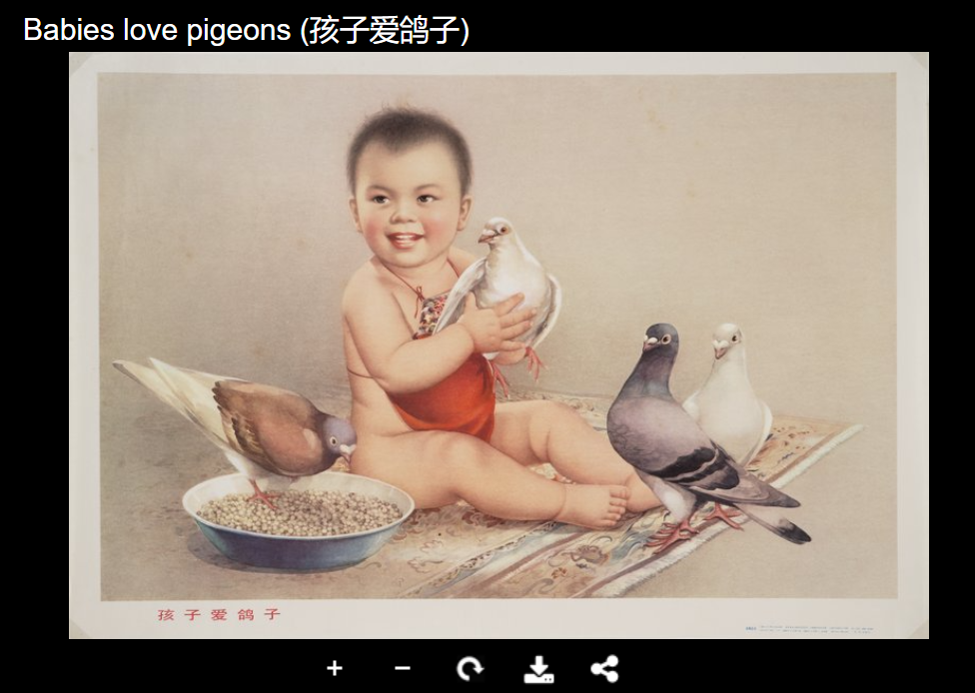
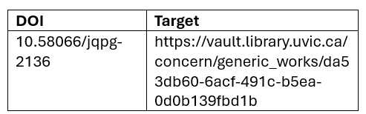
How Does Persistence Work?
URL always stays the same, redirects to content location which might change over time.
https://doi.org/10.58066/jqpg-2136
Lookup table on DOI.org server
HTTP 302/303 browser redirect
https://vault.library.uvic.ca/concern/generic_works/da53db60-6acf-491c-b5ea-0d0b139fbd1b?locale=en

Slide 4
How can PIDs fail?
Points of failure:
DOI.org server not available.
Target URL is wrong.
https://doi.org/10.58066/jqpg-2136
Lookup table on DOI.org server
HTTP 302/303 browser redirect
https://vault.library.uvic.ca/concern/generic_works/da53db60-6acf-491c-b5ea-0d0b139fbd1b?locale=en

Slide 5
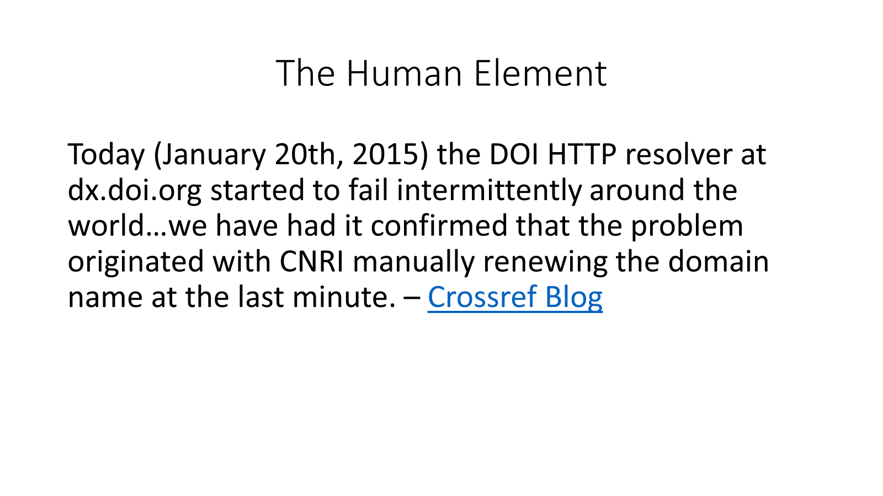
TITLE
Notes:
LG

Slide 6
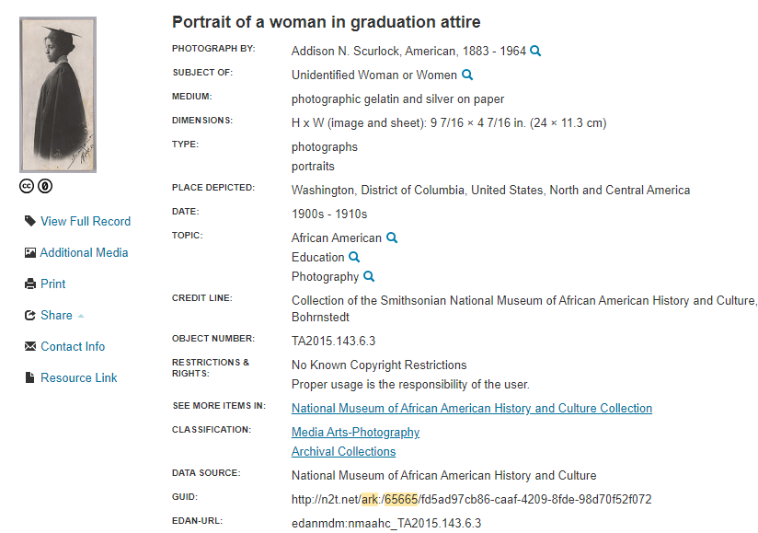
Archival Resource Keys (ARKS)
No fee for minting
Very scalable – 8.2 billion ARKs
Widely adopted in 1200+ institutions
Can be assigned to anything digital, physical or conceptual
Can use central resolver (n2t.net) OR local resolver
http://n2t.net/ark:/65665/vk7786f8901-9aa5-480a-a3a5-05fe6a3c34b0
Notes:
https://arks.org/about/comparing-arks-and-other-identifiers
https://collections.si.edu/search/record/ark:/65665/fd5ad97cb86caaf42098fde98d70f52f072

Slide 7
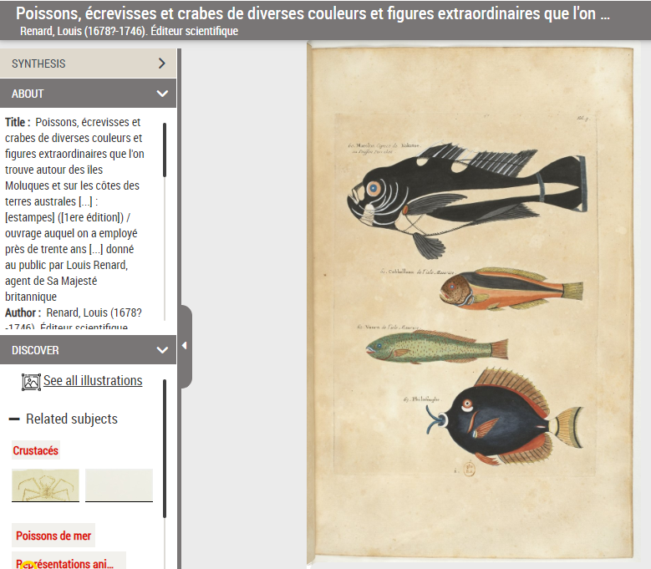

Archival Resource Keys (ARKS)
Require a server for minting – usually locally hosted.
No standardized metadata schema & no required elements.
Object metadata not stored centrally.
Don't natively enable the automated exchange of research information.
https://gallica.bnf.fr/ark:/12148/btv1b84573724
Notes:
https://arks.org/about/comparing-arks-and-other-identifiers
https://en.wikipedia.org/wiki/Handle_System

Slide 8
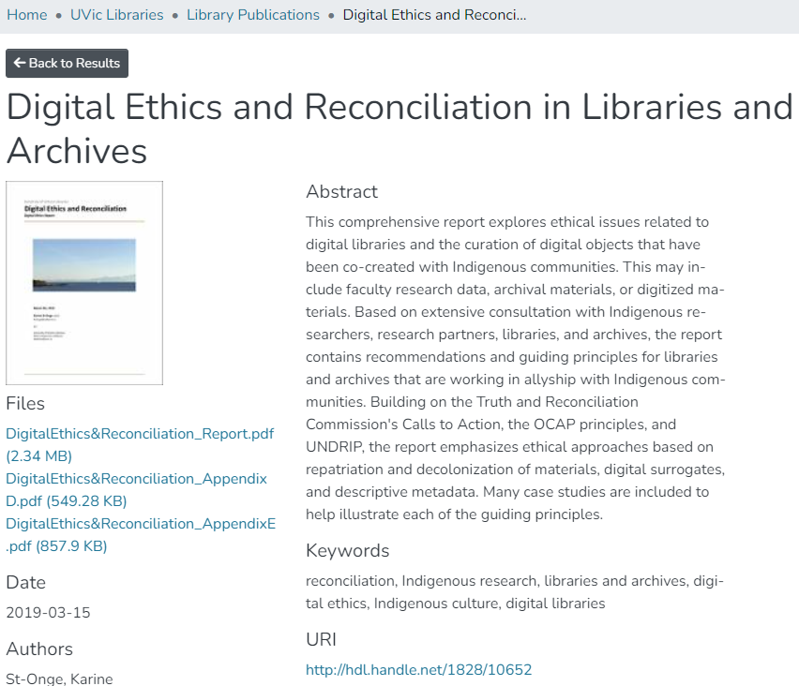
HANDLES
The HANDLE system establishes a centralized registry for PID resolution.
Small yearly fee to register institutional prefix.
No standardized metadata schema & no required elements.
Object metadata not stored centrally.
Don't natively enable the automated exchange of research information.
http://hdl.handle.net/1828/10652
Notes:
https://wiki.lyrasis.org/display/DSDOC7x/Handle.Net+Registry+Support
https://www.dona.net/prefix/resolve
The Handle and DOI schemes in addition require that the Handle protocol layer and global server grid be available at all times.

Slide 9
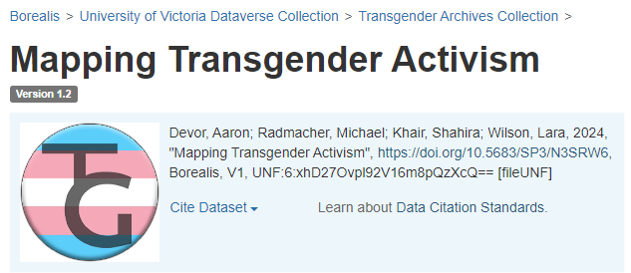
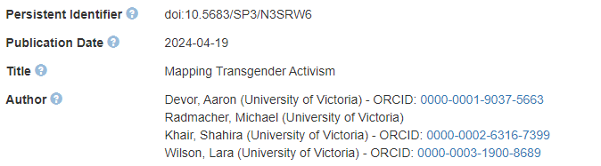
DOIS – Crossref & Datacite
Fee-based service.
Cost depends on the number of DOIs minted, although DataCite is considerably cheaper than Crossref.
Metadata schemas are not flexible, some elements are required.
Schemas are subject to updates.
https://doi.org/10.5683/SP3/N3SRW6
Notes:
LG

Slide 10
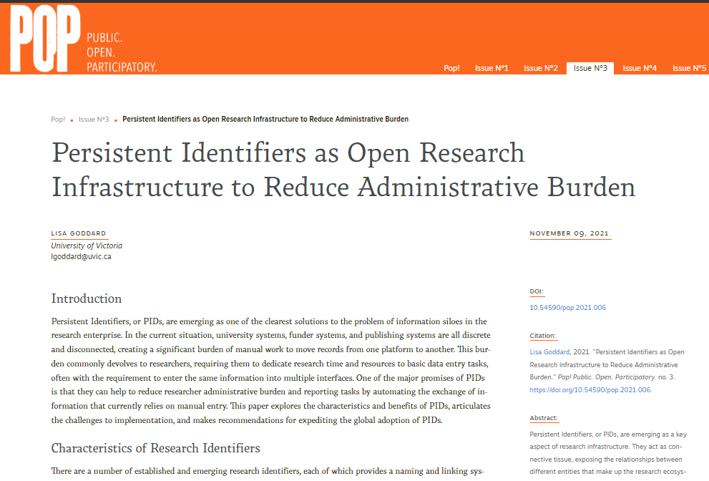
DOIS – Crossref & Datacite
Centralized name resolution servers (doi.org)
Centralized database of all DOI metadata.
Support the automated exchange of research information.
https://doi.org/10.54590/pop.2021.006
Notes:
The Handle and DOI schemes in addition require that the Handle protocol layer and global server grid be available at all times.

Slide 11
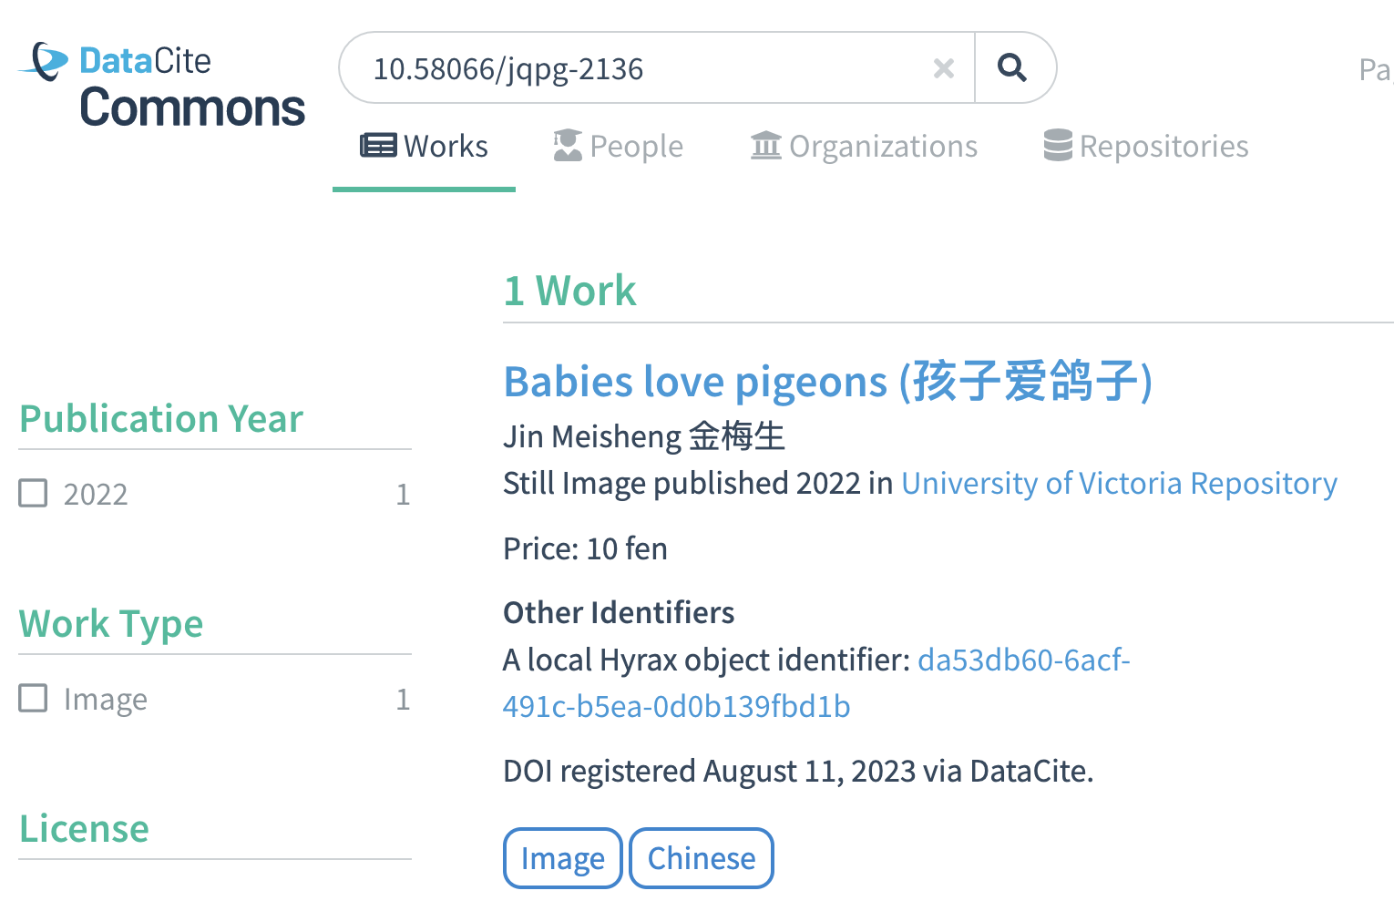
Structured Open Data - DataCite
Notes:
When I create a DataCite DOI for Babies Love Pigeons, we use an API to send basic metadata from our local record into a large central database. This database becomes a machine-readable repository of information about all of the resources that have DataCite DOIs. It is also a way for us to figure out which resource a DOI was pointing to, in the event of technical failure or human error.

Slide 12
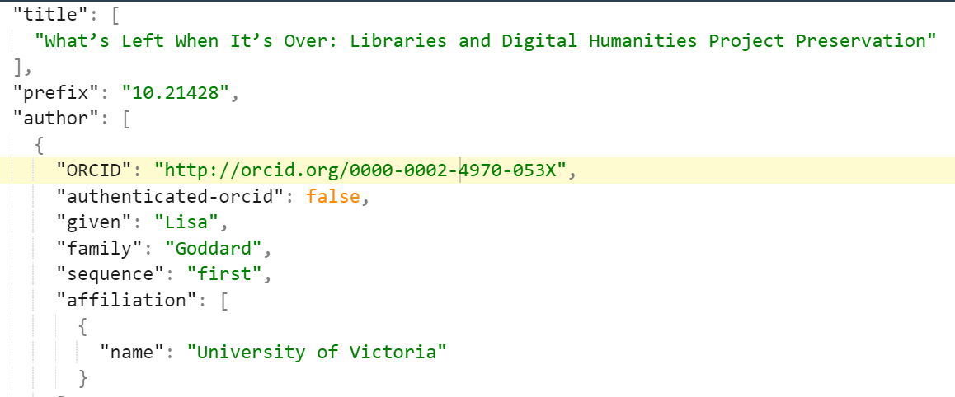
Structured Open Data - Crossref
Notes:
Looking at the JSON view of the previous Crossref record, I can see that my ORCID ID is included in the data.
http://search.crossref.org

Slide 13

ARK | Handle | DOI
Persistent URLs | Persistent URLs | Persistent URLs
Decentralized resolution | Centralized resolution | Centralized resolution
Metadata agnostic | Metadata agnostic | Standard metadata schema
Object metadata local | Object metadata local | Object metadata local & centrally aggregated
No automated exchange of metadata | No automated exchange of metadata. | Supports automated exchange of metadata between different platforms.
Free + server costs | Cheap | DataCite ($$) Crossref ($$$)
Linked Data
Notes:
LG
https://openalex.org/

Slide 14
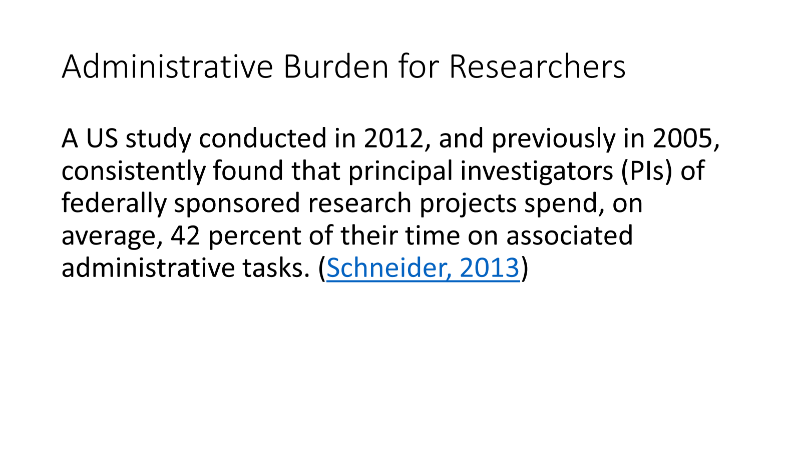
TITLE
Notes:
LG

Slide 15

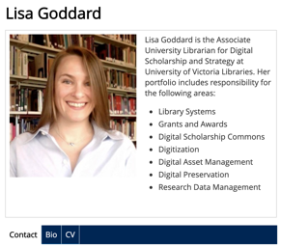


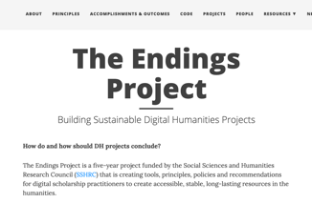
CCV
RESEARCH OFFICE
Notes:
Let’s look at how that works. Well, every time I give a conference paper, publish an article, or get a grant, I have to update a number of different sources. (E.g. CV, Canadian Common CV, Social Sciences and Humanities Research Council, Professional Profile, Department Chair, SSHRC CV, Research Office, Project Website.) This not a good model, because humans are terrible at that kind of task. We’re slow, inconsistent, error-prone, expensive, and often quite grumpy.

Slide 16

CCV
RESEARCH OFFICE
Notes:
Persistent Identifiers can help to alleviate a lot of the burden of information exchange. If I publish an article, and I include my ORCID ID, then Crossref can push that publication information directly into my ORCID profile. Other platforms can then use that ORCID ID to automatically update information about publications or grants.

Slide 17
DOI Open Data & OPEN APIS
Opportunity to seed access points all over the internet.
Vastly increase discovery & use of locally hosted digital resources.
OpenAlex
Semantic Scholar
Google Scholar
Academic Publishers
ORCID
Universities
Scholarly Societies
Notes:
LG
https://openalex.org/

Slide 18
Social Dimensions of Sustainability
Persistence is a function of organizations, not of technology; a persistent identifier system requires a persistent organization and defined processes. - International DOI Foundation
Notes:
https://www.doi.org/factsheets/DOIHandle.html

Slide 19
Who MAINTAINS PIDS for objects?
Any organization that publishes research content including:
Journal & ebook publishers
Data repositories
Research organizations
Government agencies
Libraries, archives, galleries, museums

Slide 20
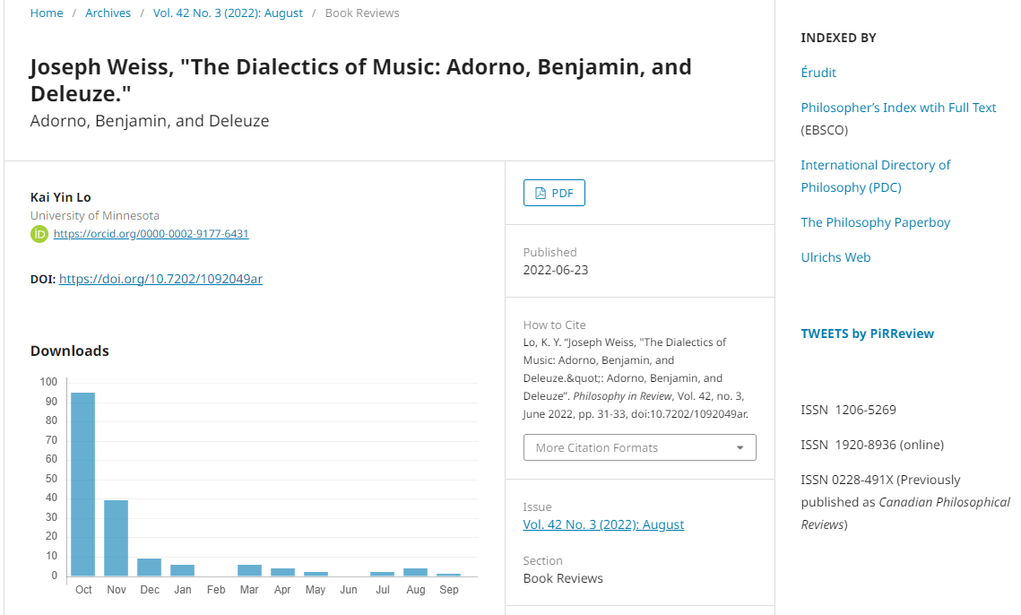
Library Support for PIDs: OJS Journal DOIs
Maintain
Crossref membership to permit
DOI minting for hosted journals.
Notes:
Many libraries maintain Crossref membership to permit hosted journals to apply DOIs to articles. This provides stable links within article citations, and also allows journal article citation data to ingested into the Crossref data hub, so it can become accessible via Crossref APIs.
https://doi.org/10.7202/1092049ar
Philosophy in review – UVic OJS

Slide 21
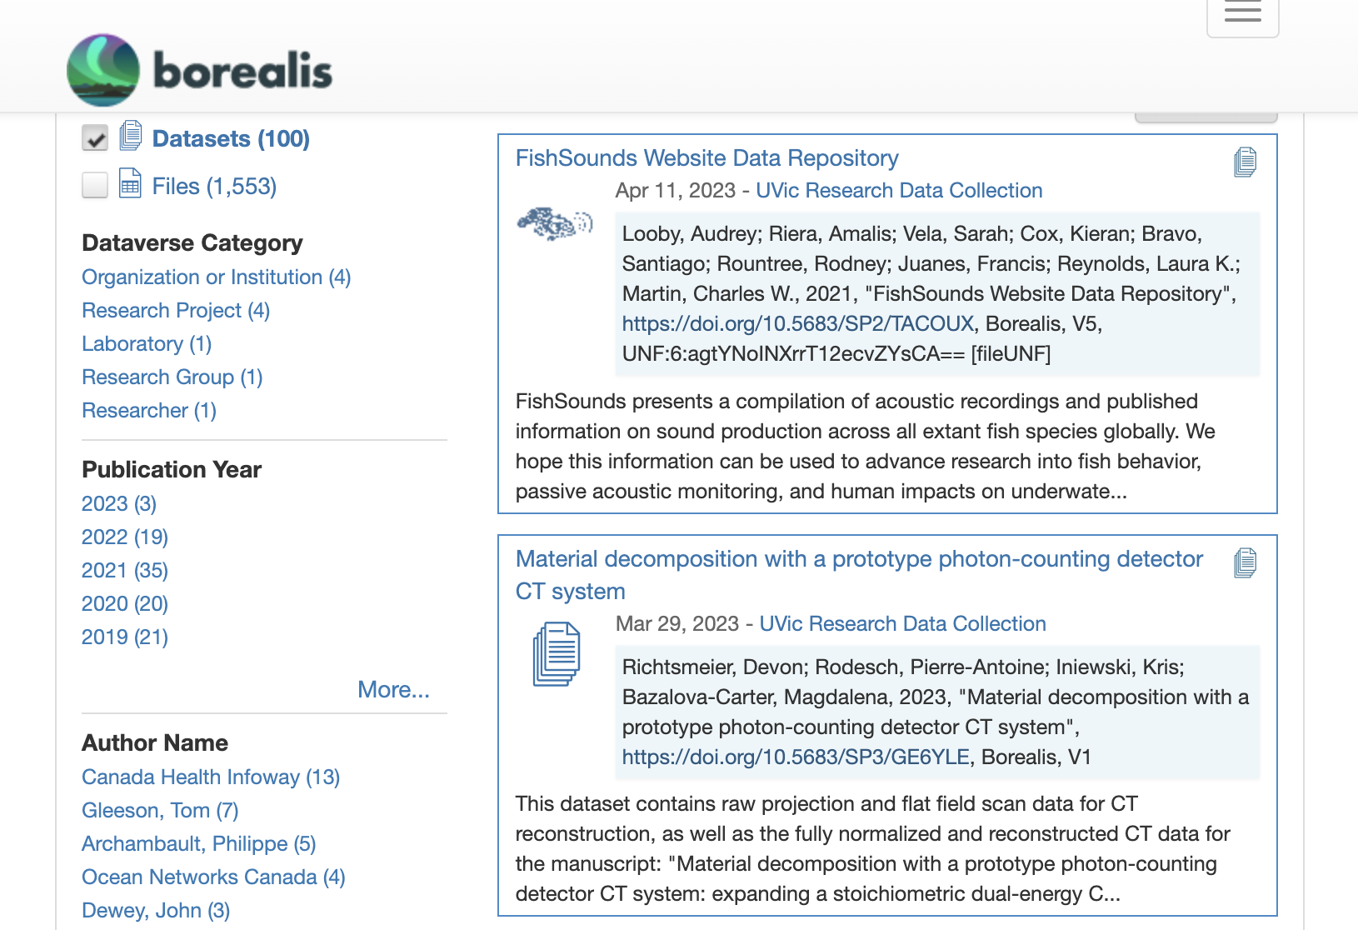
Library Support for PIDs: Dataset DOIs
Datacite DOIs for hosted research datasets
Notes:
If you are a member of Borealis, then you benefit from the Datacite membership that is maintained by Scholar’s Portal. This permits the automatic minting of DOIs for all published datasets. Many journals that require data deposit stipulate that the data repository must provide a DOI for the dataset.

Slide 22
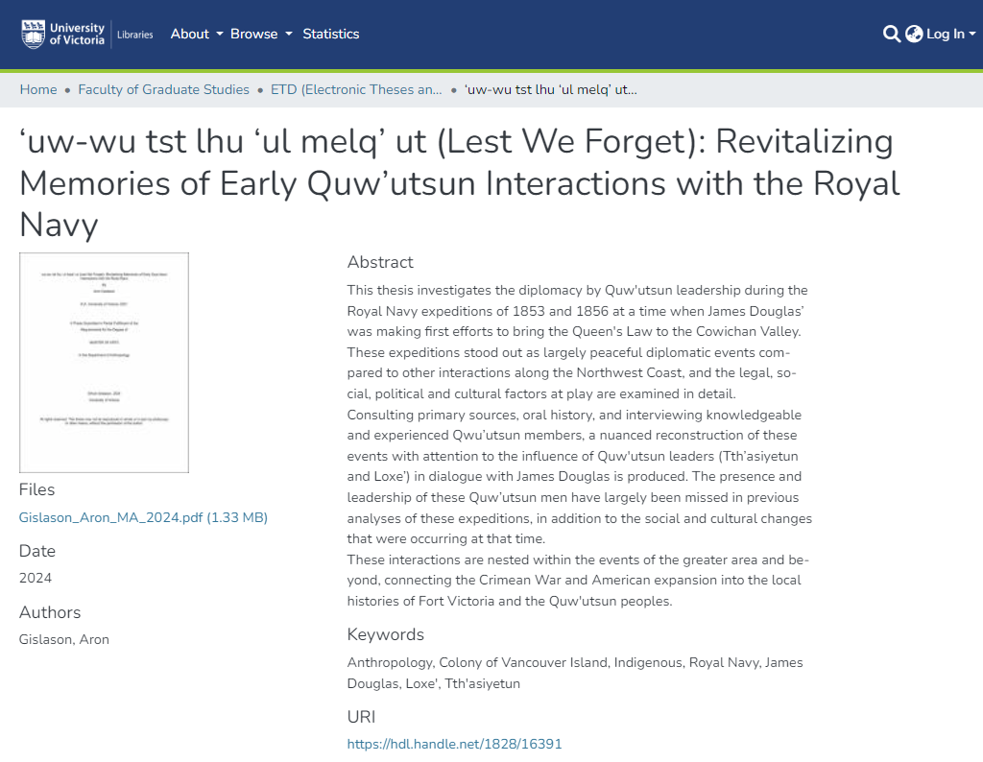
Library Support for PIDs: DSpace Handles
https://hdl.handle.net/1828/16391

Slide 23
GLAM Support for PIDs: Gaps
Theses and Dissertations often have Handles, rarely DOIs
Digitized archival & rare materials often don't have PIDs
Community and researcher collections often don’t have PIDs
Some big museums use ARKs (e.g. Smithsonian) but many don’t have PIDs for objects
Most Canadian galleries don't have PIDs for objects

Slide 24
DATACite-CA
Canadian consortium run by CRKN.
Allows Canadian content providers to mint DOIs at a reduced cost.
Memberships subsidized by the Digital Research Alliance
67 current members.

Slide 25
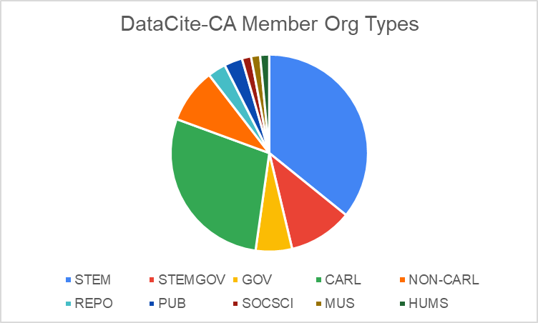
Other Libs (6)
STEM Research Orgs (24)
CARL Libs (19)
STEM Gov (7)
Other Gov (4)

Slide 26
DATACite-CA & GLAMS
25/111 public universities in Canada are DataCite-CA members
19/32 CARL members are DataCite-CA members
1 Museum member
0 Gallery members
Membership skews towards STEM
Notes:
Number of public universities in Canada from StatCan: https://www23.statcan.gc.ca/imdb/p3VD.pl?Function=getVD&TVD=1269102

Slide 27
DATACite-CA: TOp Minters
Institution | Total DOIs (all years)
University of British Columbia | 310272
Centre for Biodiversity Genomics | 146611
University of Calgary | 42810
University of Ottawa | 30087
Borealis | 20158
Vancouver Island University | 18892
Statistics Canada | 15043
University of Victoria | 13083
National Research Council Canada | 8171
Ocean Networks Canada Society | 6410
Bank of Canada | 2368
Memorial University | 1618
Canada Human-Computer Communications Society | 1216
University of Manitoba | 951
Notes:
https://www23.statcan.gc.ca/imdb/p3VD.pl?Function=getVD&TVD=1269102

Slide 28
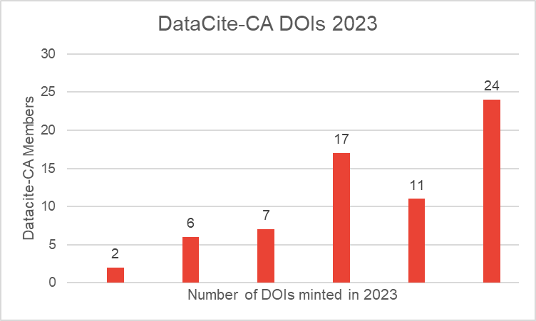
10,000+
1000 – 10,000
100 – 1000
10 – 100
1 – 10
0
Notes:
https://www23.statcan.gc.ca/imdb/p3VD.pl?Function=getVD&TVD=1269102

Slide 29
Research Questions
What are the main challenges that GLAM institutions have in terms of assigning and managing PIDS over time?
Identify best practices and tools for PID creation and maintenance, e.g. how to ensure that PIDs are updated when collections move?
What kinds of objects should have DOIs? Where are the current gaps?
What are the relative strengths of DataCite vs. Crossref? What are the strengths and weaknesses of ARKs? What are the use cases for the various object PIDs?
How to generate tombstones when material is removed? What information should be included in the tombstone record?
What happens if an institution e.g. leaves DataCite Canada? Who will maintain those DOIs over time.
Notes:
How do models like Dataverse, with researcher-contributed metadata, ensure that DOI schema reqs are fulfilled?
Is there any conscious mapping of mandatory fields in national platform to mandatory fields in DOI schemas?
How many ORCIDs are in Dataverse?
Next instance of Dspace (8) there will be a two-way entity API so DSpace can update ORCID records.

Slide 30
Next Steps
Survey of GLAM institutions in Canada
DataCite members
CARL & CRKN Libraries (and affiliated Archives)
What kinds of objects currently have PIDs? What kinds of PIDs?
What objects don’t currently have PIDs? Why not?
Museums? Archives?
Notes:
How do models like Dataverse – researcher metadata
Is there any conscious mapping of mandatory fields in national platform to mandatory fields in
Next instance of Dspace (8) there will be a two-way entity API so DSpace can update ORCID records.
How many ORCIDs are in Dataverse.

Slide 31
Thanks lgoddard@uvic.ca
Notes:
LG

